Slide 1
Buffering Against
Instability
18 April 2024
Presented by
Ian Hill
Director at G911

Slide 2
Umvoti G911– Short Term Funding Requirement
Income
Expenses
Rands
Donations
Model
Transition Period
(2 Years)
Membership
Subscription Model
Time

Slide 3
Umvoti G911– Short Term Funding Requirement
Donors required to “Bridge” the gap
Income
Expenses
Rands
Donations
Model
Membership
Subscription Model
Time

Slide 4
Umvoti G911 – The Crime Line
BEFORE
DURING
AFTER
PREVENTION
Id High Risk Areas
Courses
Crime incident
LPR
G911
SAPS
Fire
Medical
Security
Community
Investigation & Prosecution
Coordination of Community & resources
Victim
Response
Security Audit & Bench-marking
Relationships
Training & Tech
Support & Assistance
Develop solutions for issues
Communication
PROACTIVE
REACTIVE

Slide 5
Umvoti G911– Vision
The Company’s main objective is to improve the Safety and Security in Umvoti for the benefit of its members and the broader community as a whole by, inter alia, the following:
initiating and participating in initiatives that prevent and reduce criminal activity;
building and fostering relationships with all sectors of the community and all emergency services operating in Umvoti;
providing a 24 hour control centre aimed at providing enhanced and proficient communications services to members ;
engaging with investigators and the members of the judiciary regarding serious crimes committed against members with a view to assisting members in the process of obtaining justice.

Slide 6
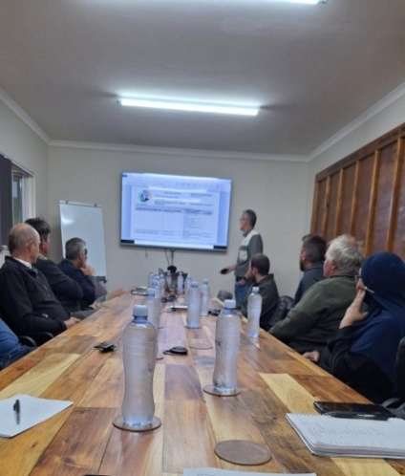
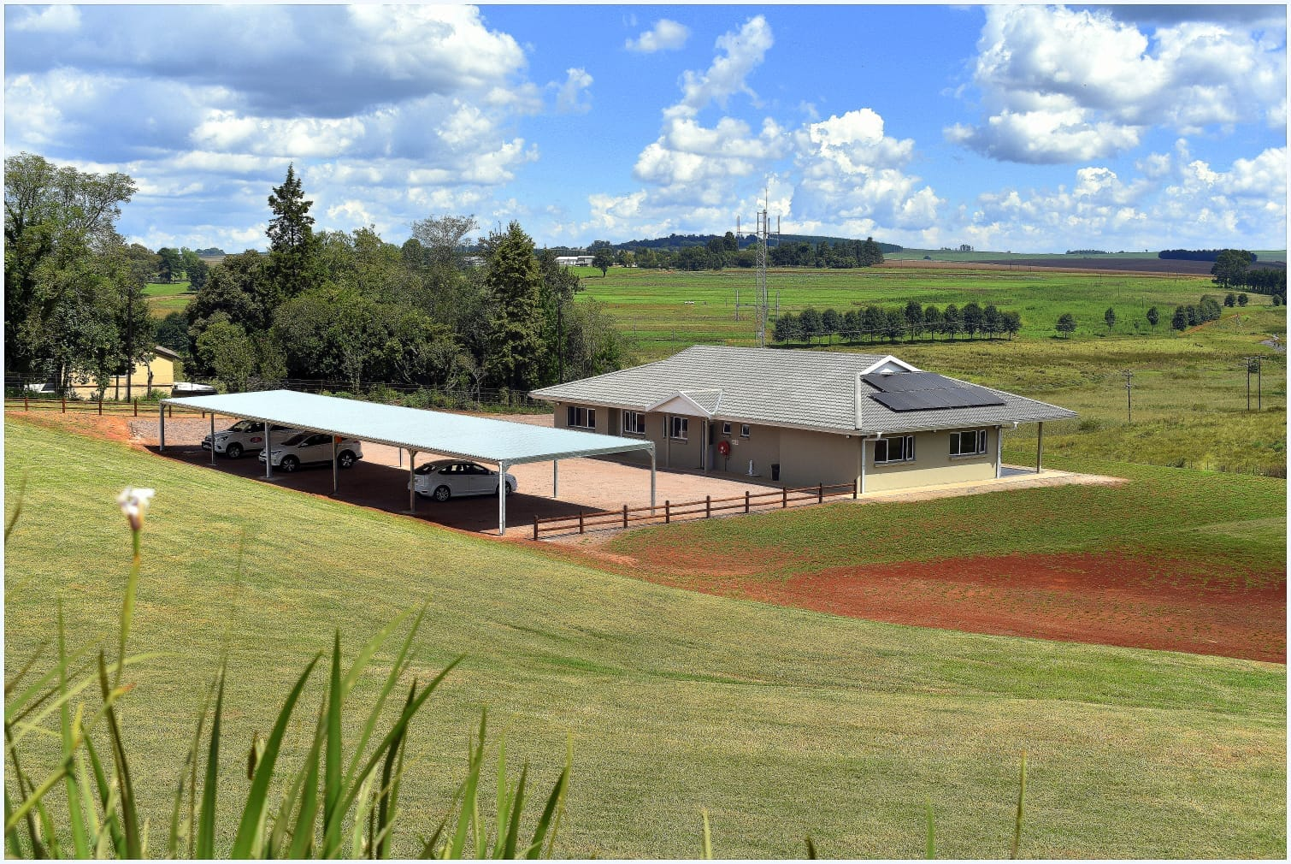
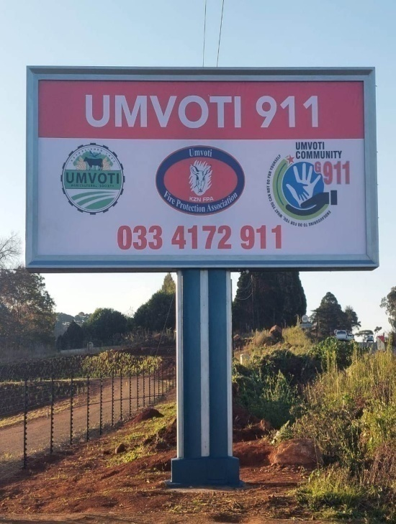
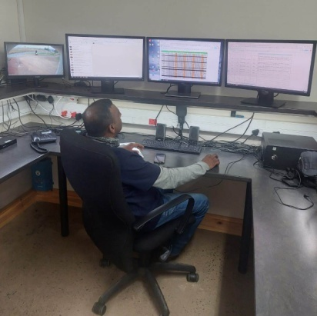
Umvoti G911– 2024 HQ

Slide 7
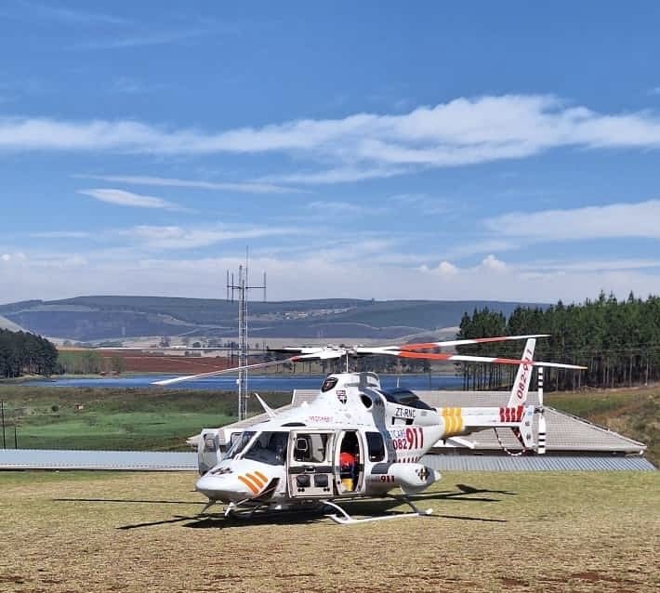
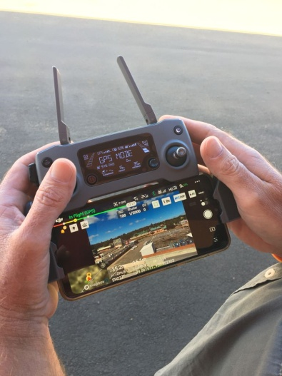
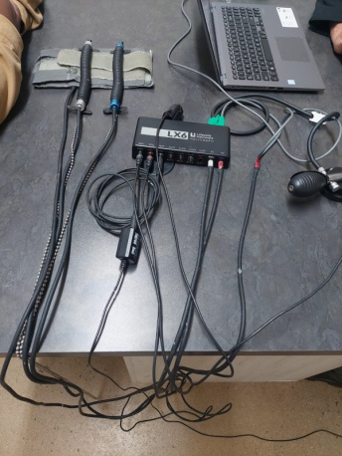
Umvoti G911 – 2024 resources
Drone
Helipad
Polygraphs

Slide 8
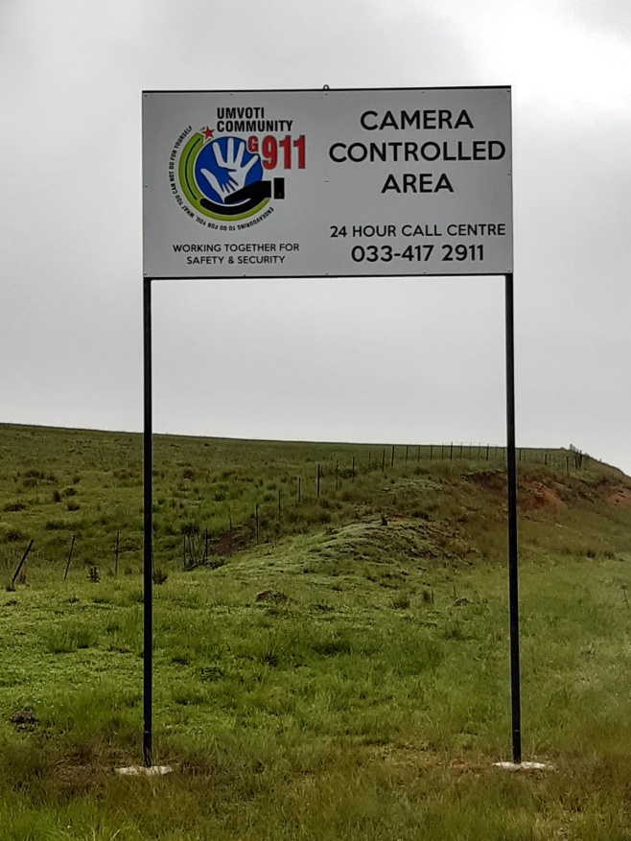
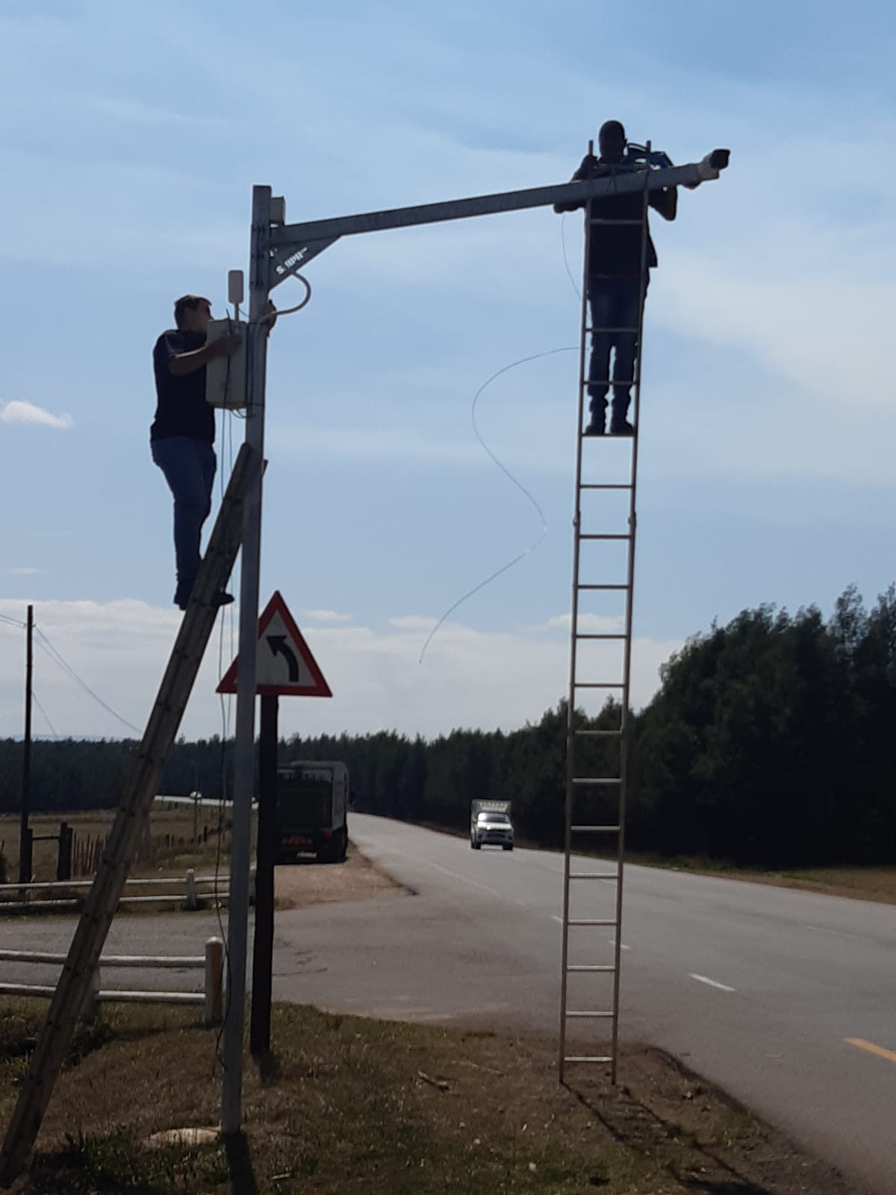
Umvoti G911 – 2024 Initiatives
Zones & Patrols
Licence Plate Recognition
12 Sites with 24 LPR Cameras
Dedicated response group
Ave Monthly Results:
6 – 10 arrests
4 vehicle impounds

Slide 9
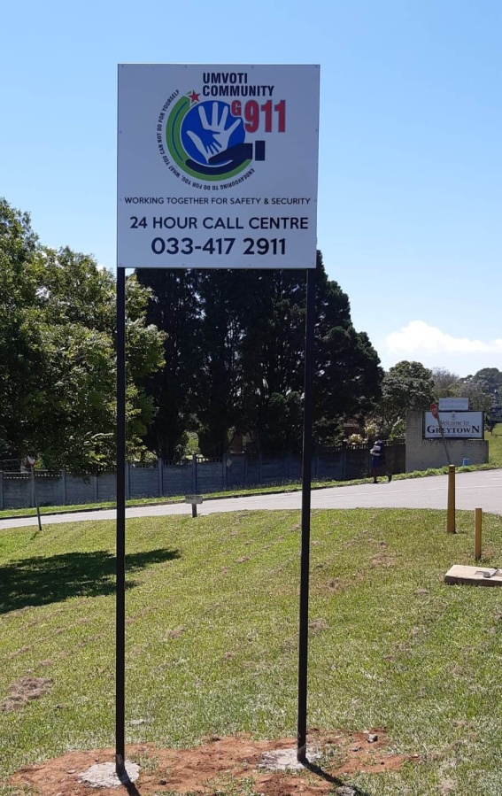
Umvoti G911

