Slide 1

KZN
UNREST
July 2021
Presented: 18 April 2024

Slide 2
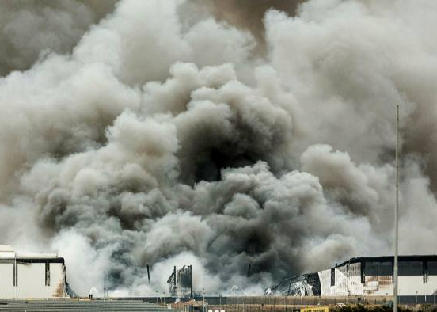
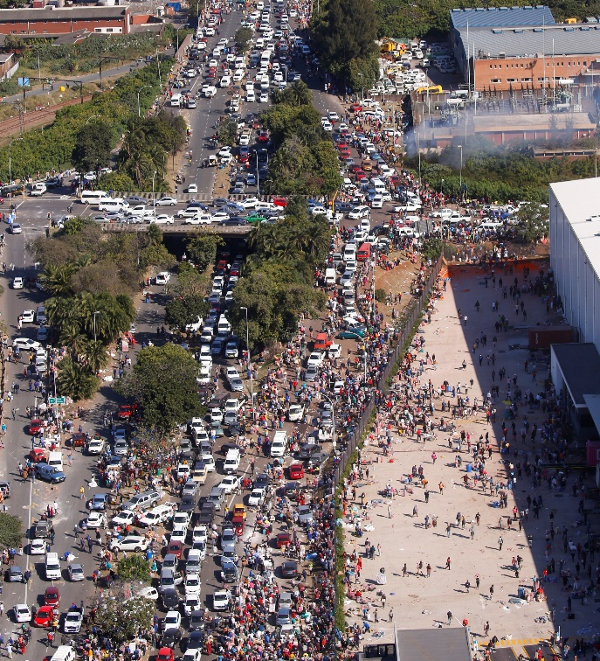
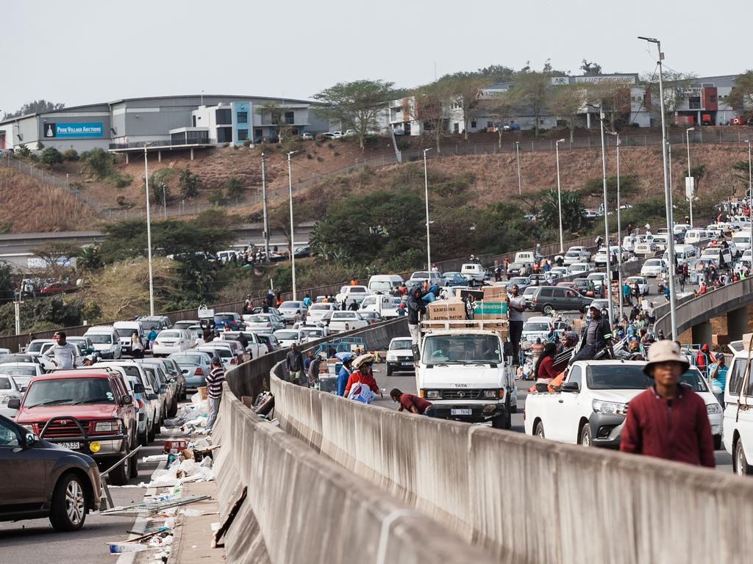
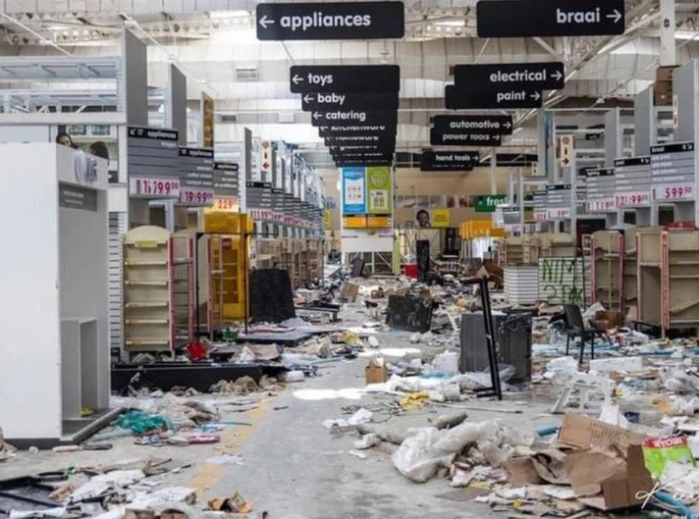

Slide 3
Real time snapshot taken on 14 July 2021
(110 farmer community leaders)
Key observations:
Orchestrated
Criminality
No or little assistance / response from safety and security forces
Absence of intelligence
Leadership challenges
No or Restricted trading
Entire value chain impact
Economic shock

Slide 4
Kwanalu Action – United we can
Kwanalu daily Leaders JOC (65+) incl
  Fact check *
  Collection of Intel and fact-based approach
    110 farmer community & commodity leaders
    (result was first hand real time accurate information)
Identified key strategic issues
Co-ordinated actions
  Rural Stability and Security *
  Farmer led
  Key routes / Critical Economic Points
  Essential services
    Communications, movement of goods and services etc.
  Humanitarian and local aid requirements
Economic impact
Business stimulus package

Slide 5
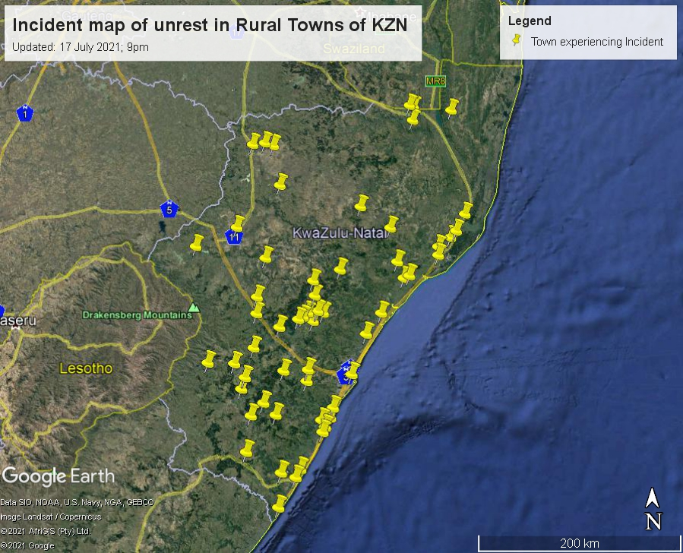
Kwanalu:
57 pins which includes:
Sugar refinery in Durban
9 sugar mills
1 Eskom Sub-Station
Which are high risk economic targets.
Notes:
57 pins which includes:
Sugar refinery in Durban
9 sugar mills
1 Eskom Sub-Station
Which are high risk economic targets.
In the case of the sugar mill, there is not an additional pin included for the town unless the town is some distance from the mill. E.g. There are two pins for Pongola Mill and Pongola separately and there is a separate pin for Noodsberg mill, the rest of the mills represent towns. Consequently there are:
2 discrete sugar mills
1 Eskom Sub station
1 Sugar refinery, and,
53 towns, of which 7 include sugar mills.

Slide 6
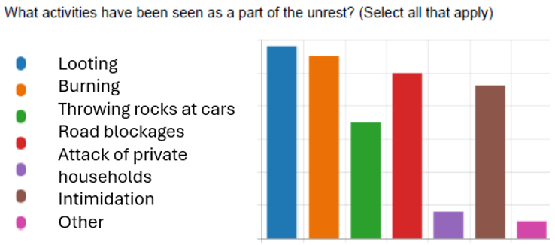
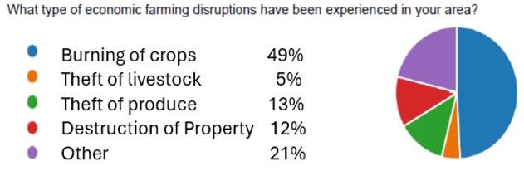

Slide 7
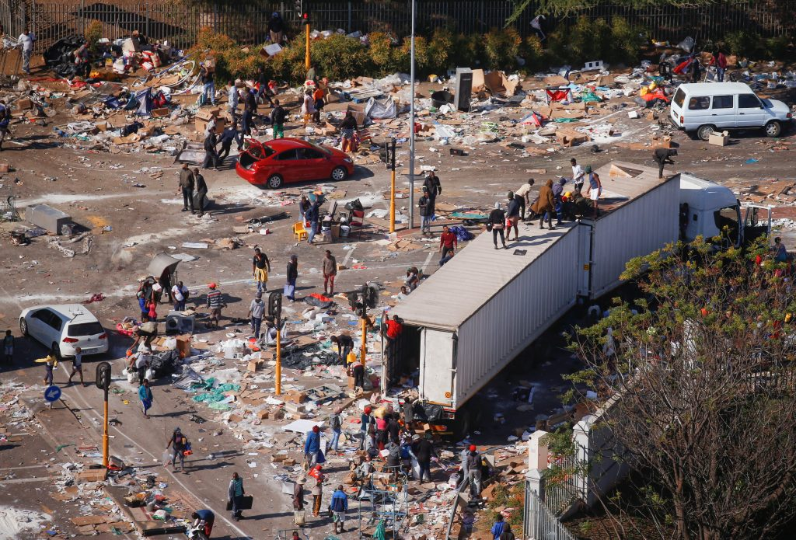
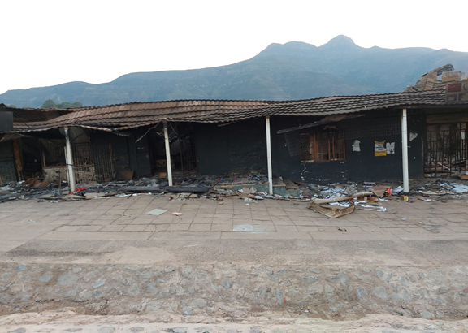
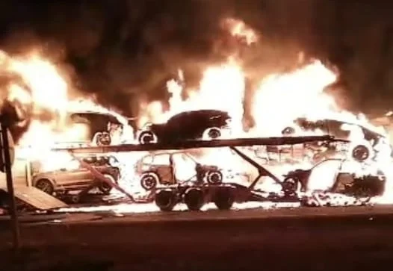
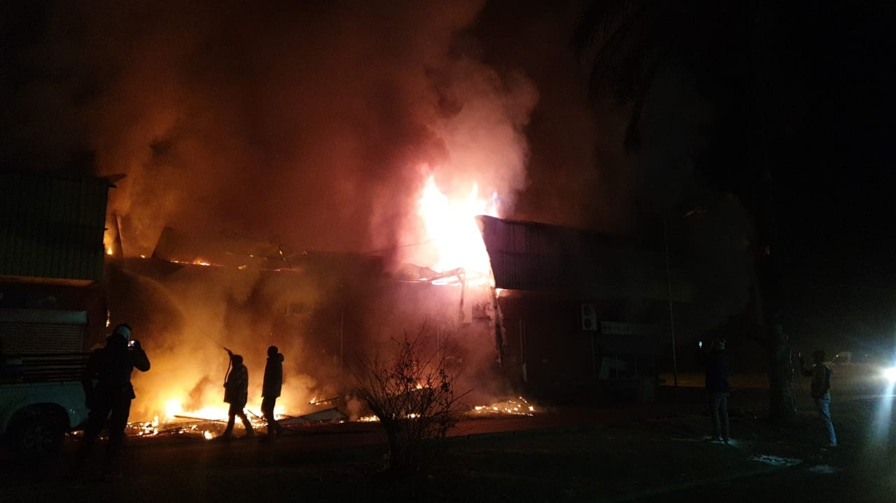
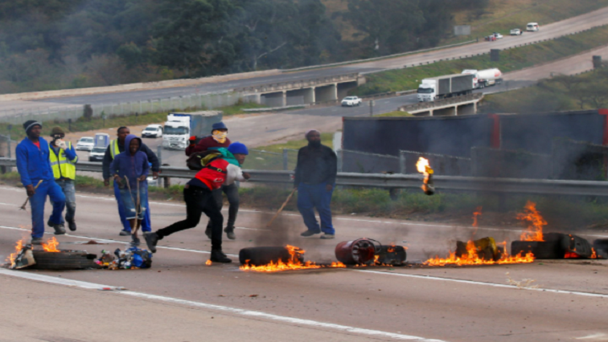
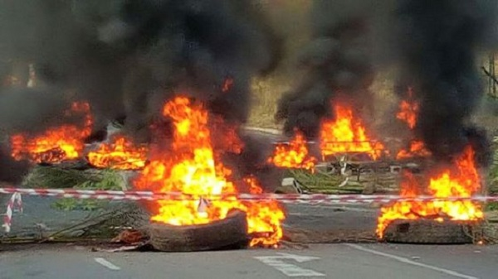
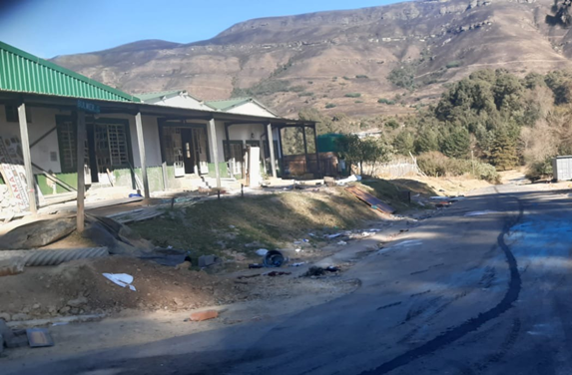
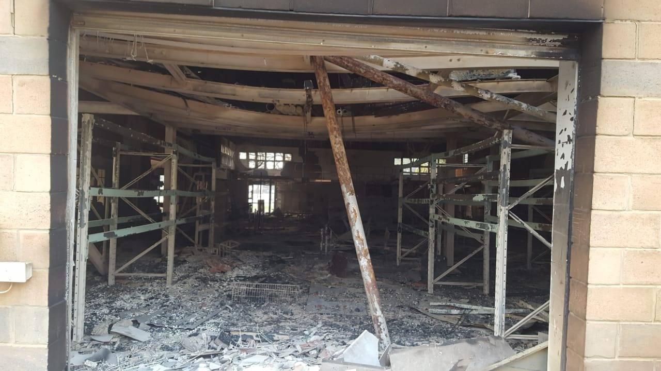
KZN
Loot - Strip -
Burn

Slide 10
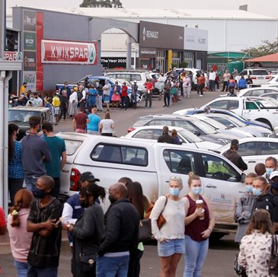
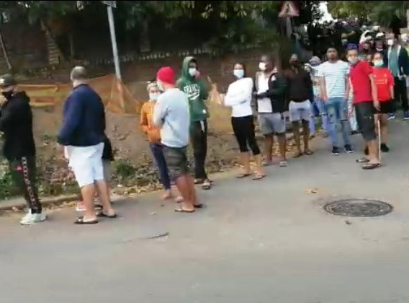
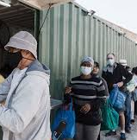

Slide 11
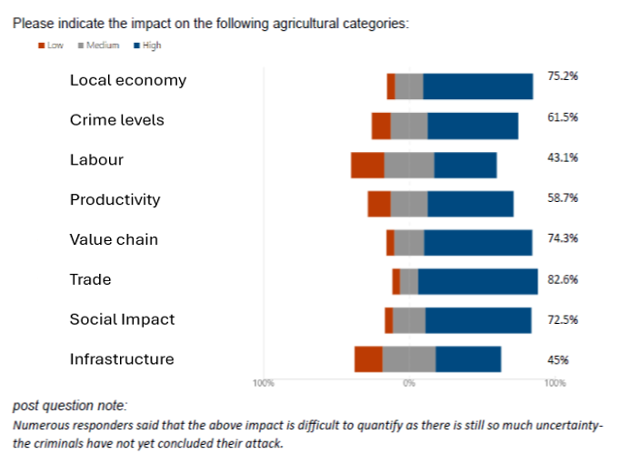
As @ 16 July 2021

Slide 12
Types of losses (@ 18 July 2021)
Direct to farmer
Infrastructure losses
Direct security costs
Value chain
Concern:
  little or no recovery support
Notes:
Types of losses early count (18 7 21 Subject to change!)
Direct to farmer R 259 735 942
Infrastructure losses R 41 310 446
Direct security costs: R 1 259 000
Value chain R 560 896 000
Other direct costs R 8 521 250
Total: R 871 722 638

Slide 13
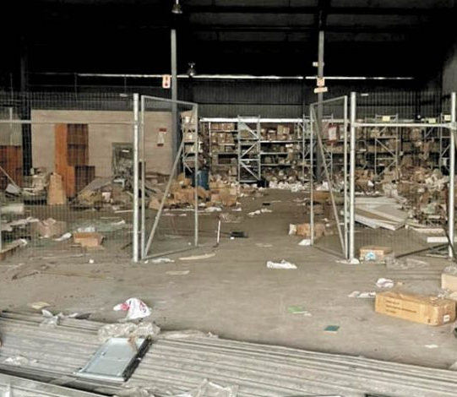
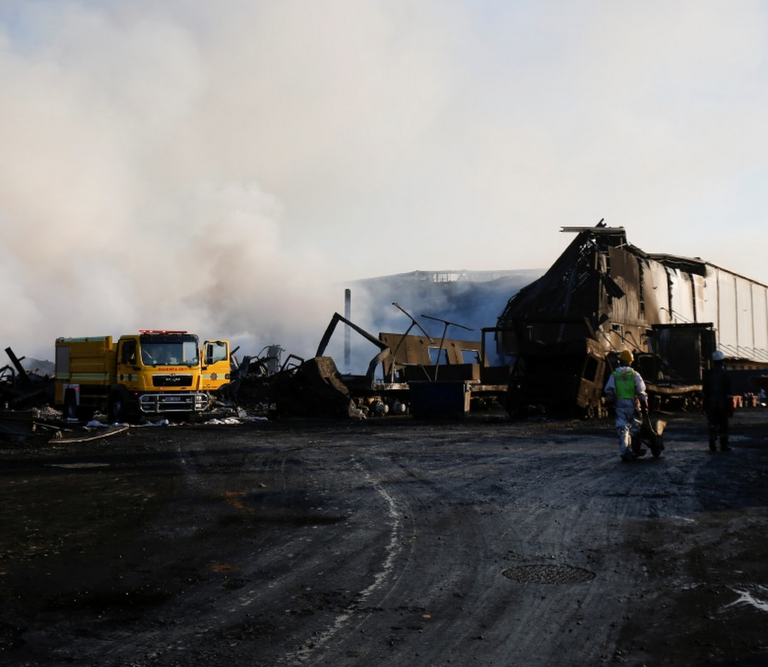
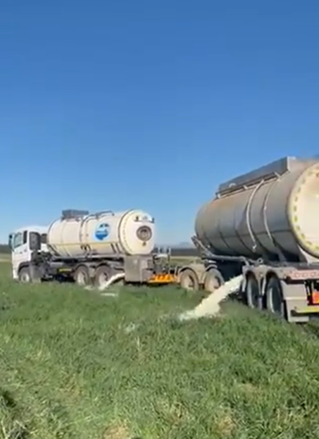
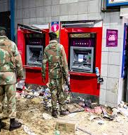
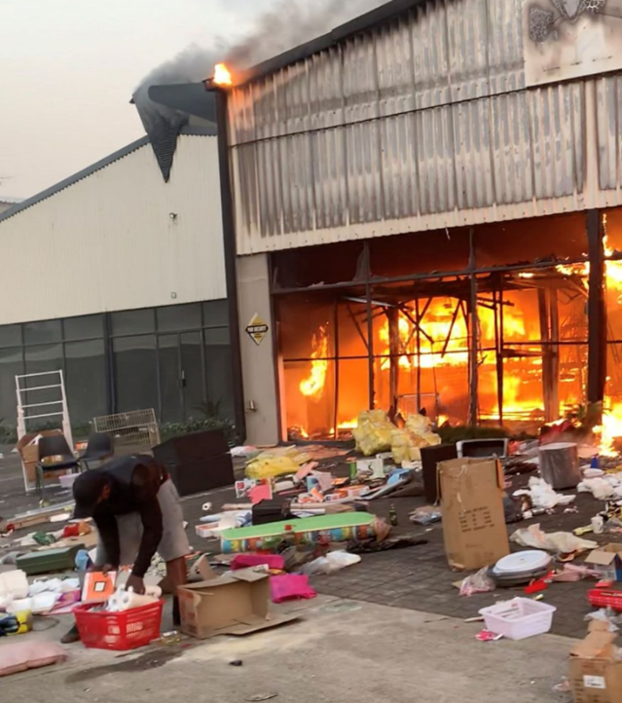

Slide 14
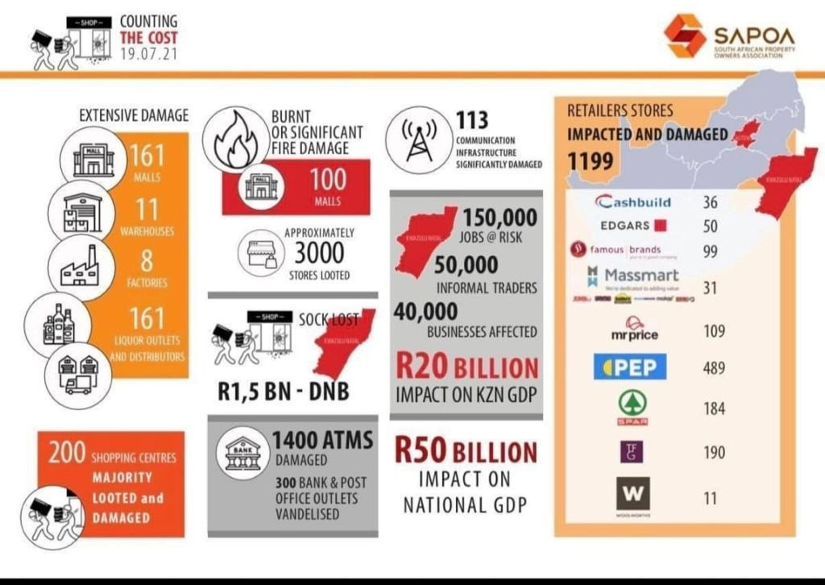

Slide 15
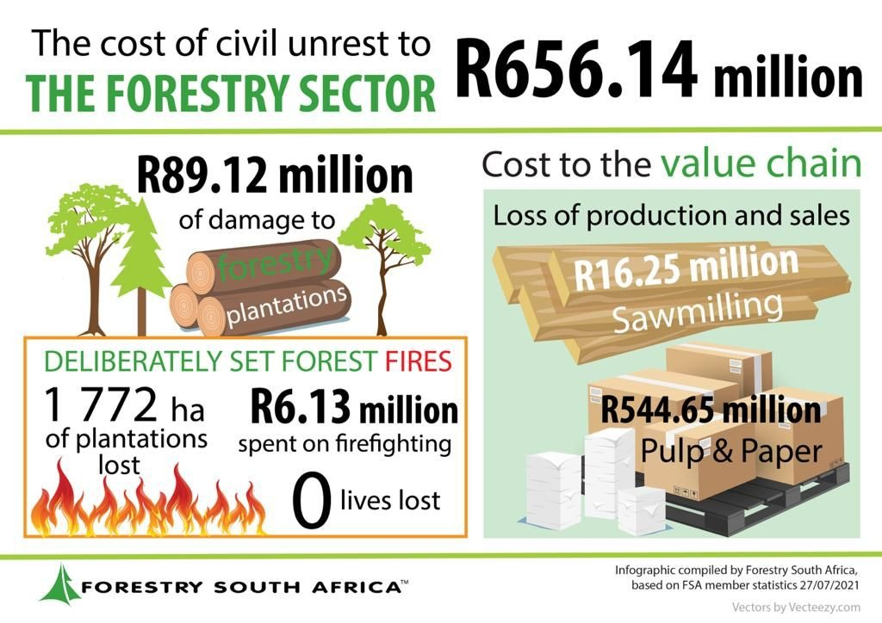

Slide 16
eThekwini Municipality – Economic development and planning cluster 4/8/21
Research reveals that for every hour that the N3 highway in KwaZulu-Natal is closed, at least R1m lost to the economy.
  This means that the 5 days unrest = estimated at R120m.
  There were more than 37 trucks that had been torched in various parts of the province (28 were torched in Mooi River)
Contributed to the weakening of the Rand. The local currency dropped as much as 2% against the dollar in the wake of these riots.
Impact on fuel and transportation of goods
  Exacerbating the situation is the impact this has on food security.
More than 150 000 jobs at risk to be lost

Slide 17
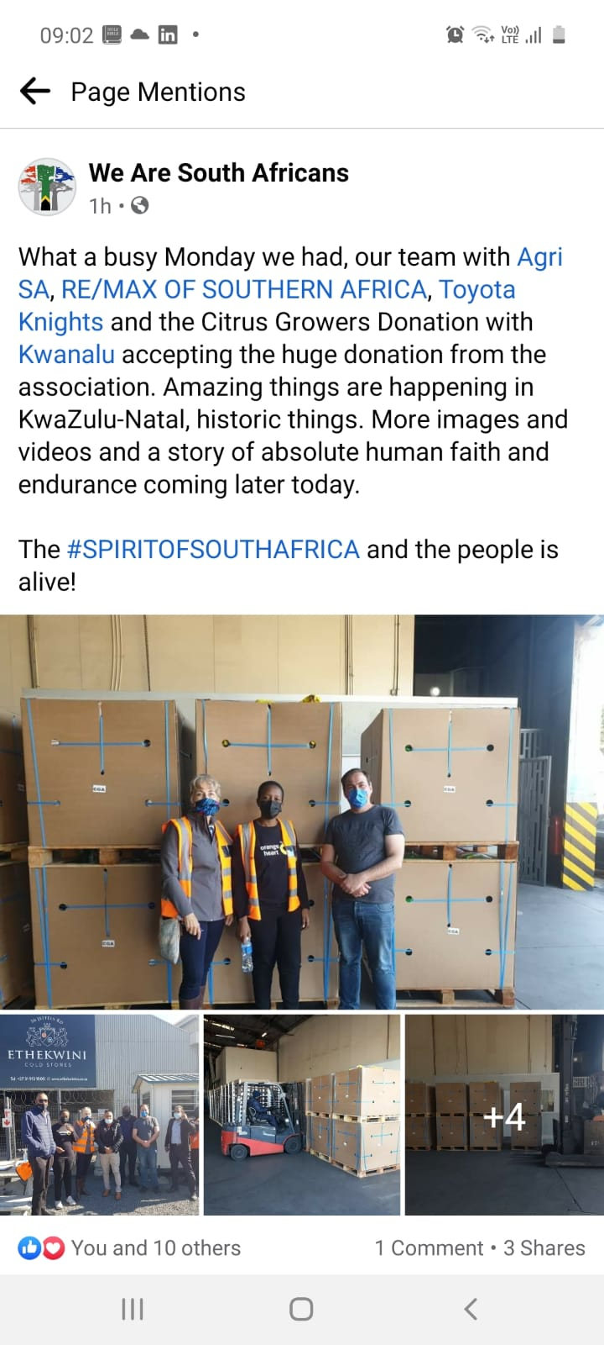
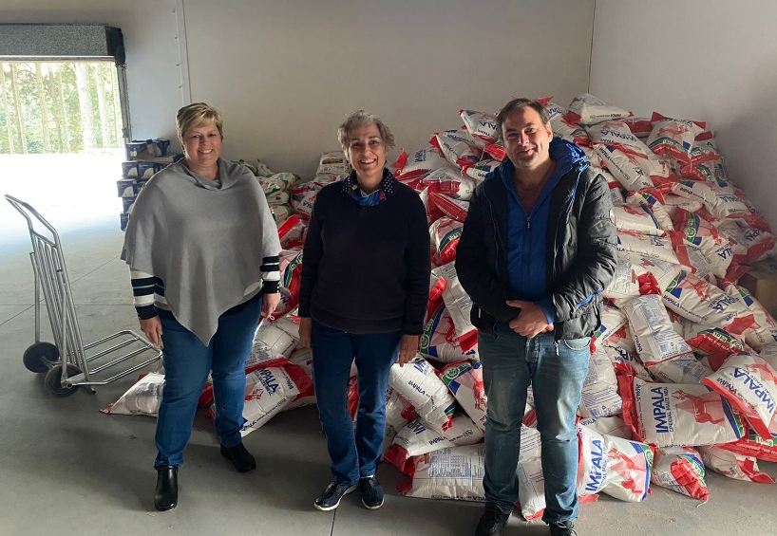
Kwanalu response:
(donor funded)
A Humanitarian Aid Programme to assist farmers, farm workers, small holders and vulnerable communities.
500 000 people assisted
More than 15 partners
(A Business Restoration Programme to assist rural town businesses recover.
A Rural Entrepreneurship Programme underpinned by leadership & business training with mentorship aimed at providing opportunities to youth and women in rural towns.

Slide 18


Kwanalu Actions and Lessons learnt
Kwanalu control centre (JOC)
  Farmer led Leadership
  Good communication and sound advice
  Fact Check
Co-ordinating actions
Communication methods (Cell towers, radio’s)
National, Provincial, Commodity & Business linkages and cooperation
Identify key strategic issues and collaboration
  SANDF. SAPS, pvt Security
  National Rural Safety Strategy

Slide 19

Lessons learnt:
Intelligence
Knowing your rights
Sound advice
Critical economic nodes
  High risk areas, High cost of impact/unrest
  Routes include: N3, R34, R102, R103
  Key node: Move N3 Mooi River Toll Plaza (relocate/remove)
Movement of goods and services
Business incubation and stimulus package
  WYRE

Slide 20


“UNITED WE CAN”

Slide 21
The strategic focus of Kwanalu is to provide leadership on rural and agricultural issues. With emphasis on all aspects pertaining to economic sustainability, security, risk management, rural development, and land tenure.
Thank you
NOTICE: The information contained in this document may be confidential, legally privileged and protected by law. Access by the intended recipient only is authorized. If you are not the intended recipient, kindly notify the sender immediately. Unauthorised use, copying or dissemination hereof is strictly prohibited. Kwanalu does not accept responsibility for the contents or opinions expressed in this e-mail, nor does it warrant this communication to be free from errors, contamination, interference or interception. Kwanalu property Distribution or Copying without permission will result in Legal Action. Kwanalu accepts no liability of whatever nature for any loss, liability, damage or expense resulting directly or indirectly from the use of any information contained in this document.

